Slide 1
StreamVault
Video Streaming
Websites
Hazem Fayad 192200135
Hussein Mohamed 192200112
Mahmoud Sameh 122300010
Mariam Mohamed 192200064
Mina Magdy 192200159
Supervised By: Dr. Fatma Sakr
T.A: Eng. Doaa Amin , Eng. Fady Romany

Slide 2
What is StreamVault?
StreamVault is movies & series streaming website with rating and playback speed mechanism.

Slide 3
Webpages of StreamVault
01
Sign Up Page/Login Page
02
Admin Page
03
Home Page
04
05
06
Browse Page
Search Page
Profile Page
01
02
03
04
05
06

Slide 4
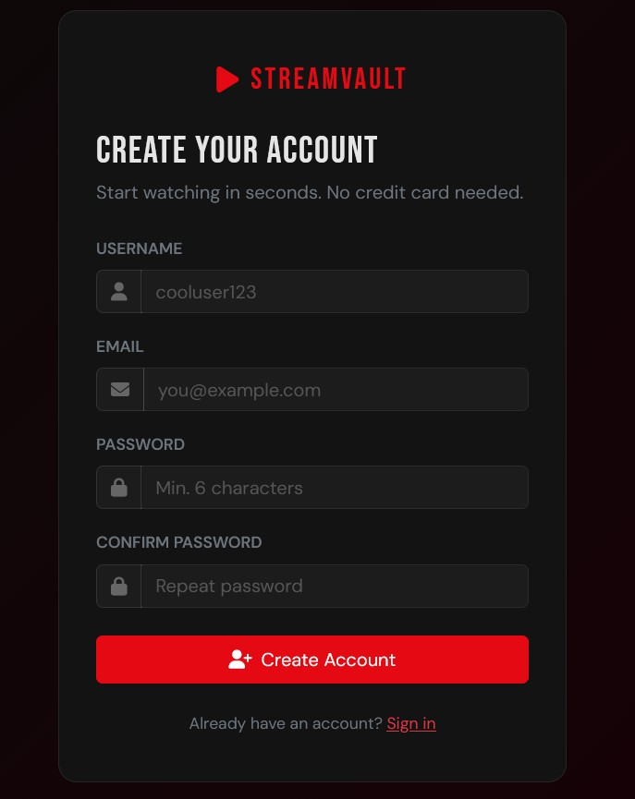
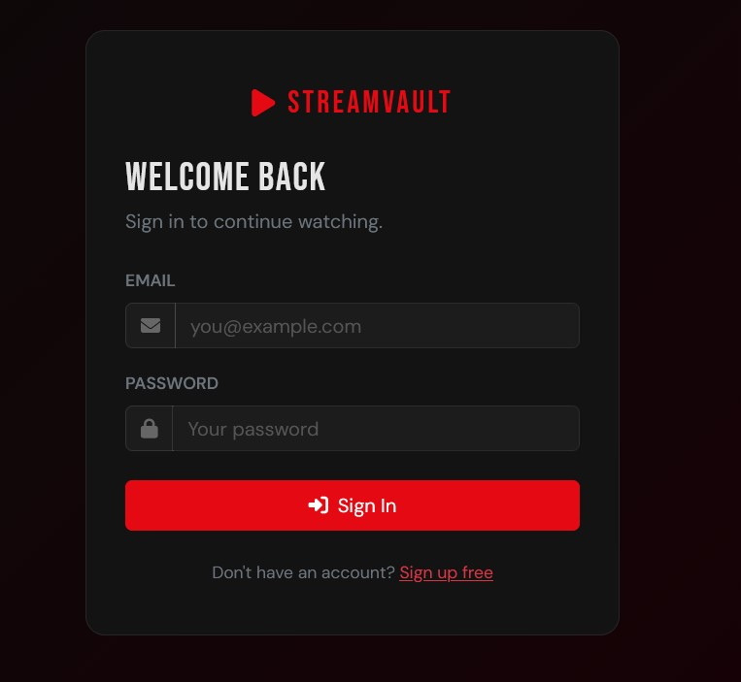
Sign Up/Login Page
SignUp/In
HomePage
Admin Page
Browse
Search
Profile
01
Responsible for creating user account/Logging the user to the home page.

Slide 5
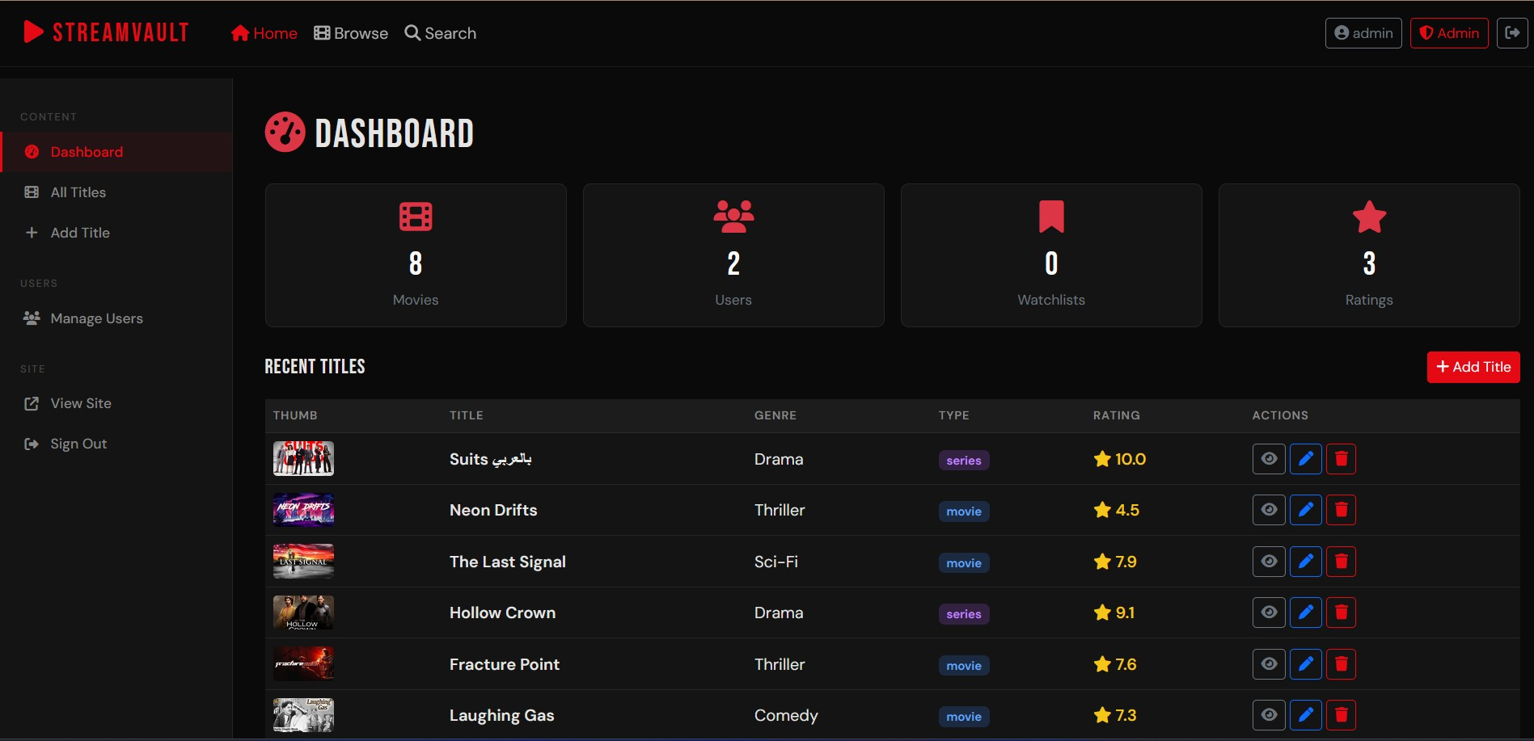
Admin Page
SignUp/In
HomePage
Admin Page
Browse
Search
Profile
02
For the admin to manage web pages and the database of the website.

Slide 6
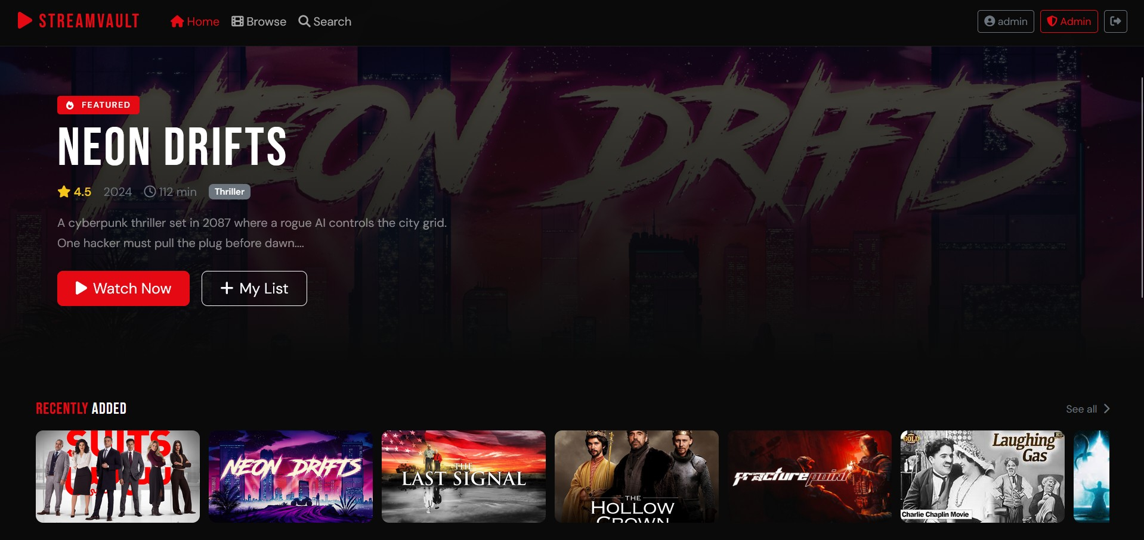
03
Home Page
SignUp/In
HomePage
Admin Page
Browse
Search
Profile
03
Display new and featured movies and series to user to watch them.

Slide 7
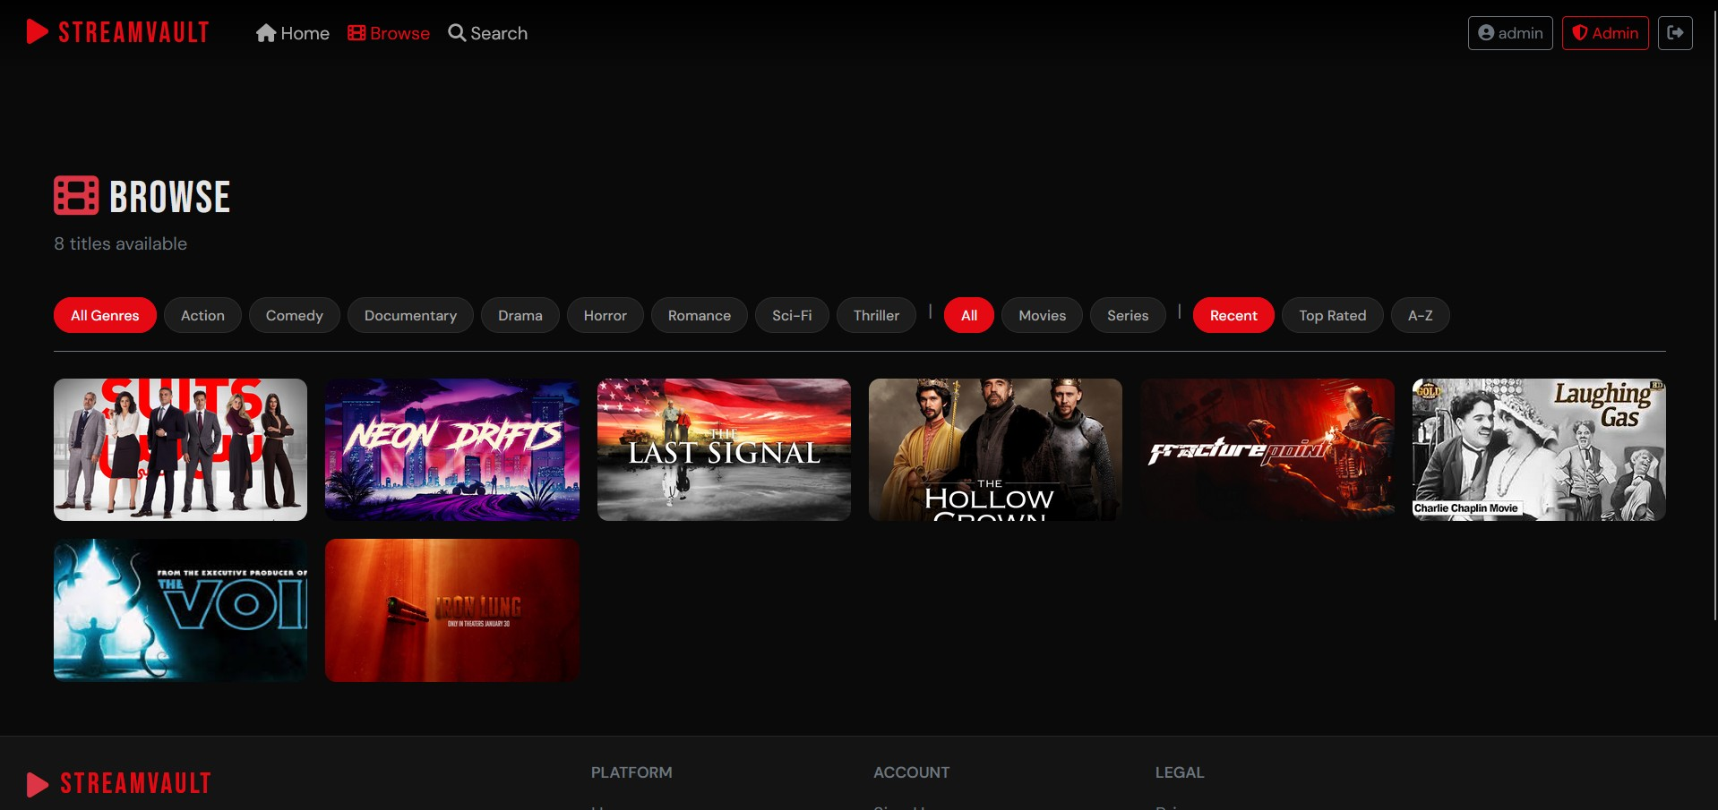
04
Browse Page
SignUp/In
Admin Page
HomePage
Browse
Search
Profile
04
Displays all movies and series from the database to user.

Slide 8
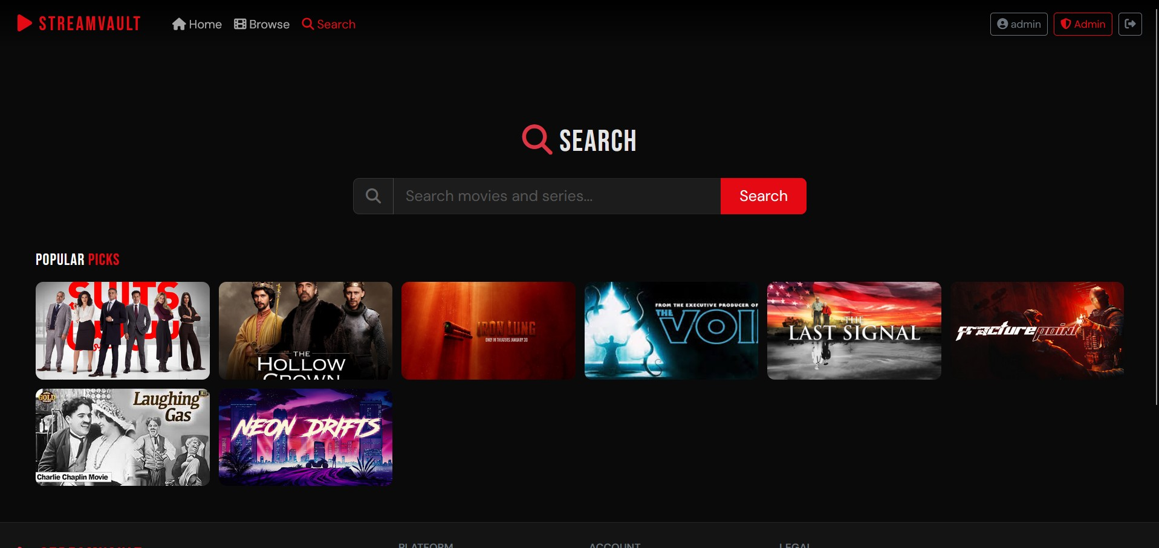
05
Search Page
SignUp/In
Admin Page
HomePage
Browse
Search
Profile
05
The ability for the user to search for the desired movie/series

Slide 9
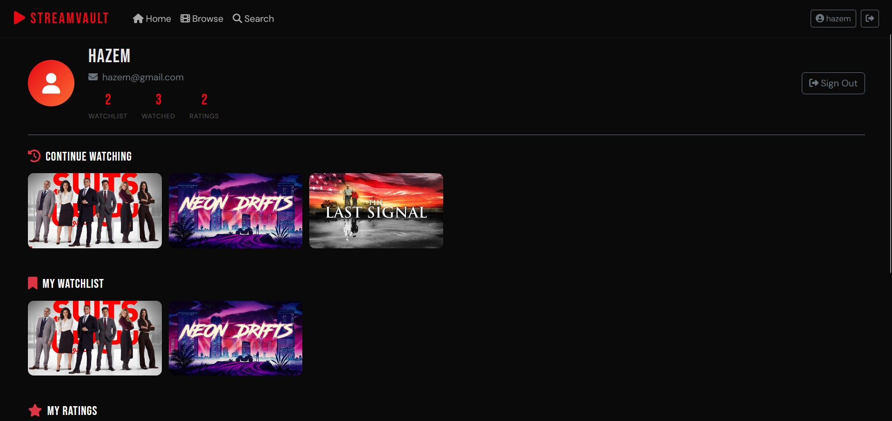
Profile Page
SignUp/In
Admin Page
HomePage
Browse
Search
Profile
06
Displays the user’s detailed information.

Slide 10

Made with❤️with for cinema lovers.
THANKS FOR WATCHING!

